Slide 1

Cloud Basics

Slide 2
What is Cloud ?
It's all of the things you can access remotely over the Internet. When something is in the cloud, it means it's stored on Internet servers instead of your computer's hard drive
Why we use Cloud ?
Convenience
Reliability
File storage
File sharing
Backing up data

Slide 3
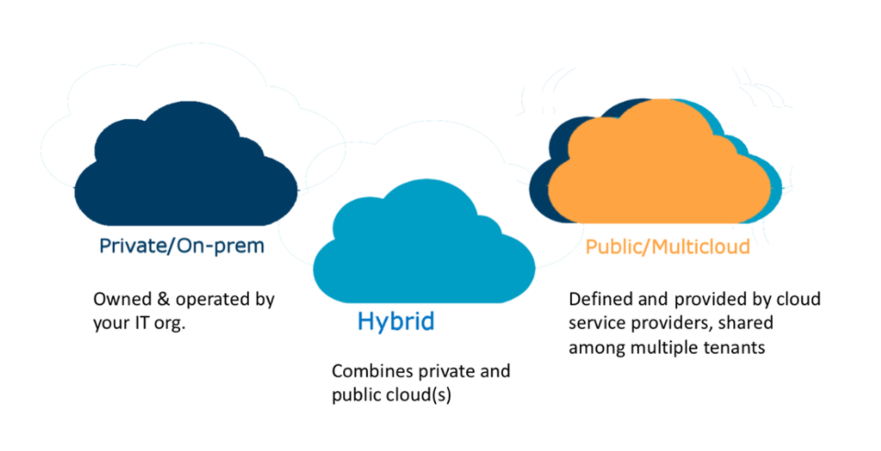

Slide 4
Cloud Computing
Cloud computing computing is the on-demand availability of computer system resources, especially data storage and computing power, without direct active management by the user.
Types of Cloud
There are three main types of cloud environment, also known as cloud deployment models.
Businesses can choose to run applications on public, private or hybrid clouds – depending on their specific requirements.

Slide 5
Public Cloud
A public cloud environment is owned by an outsourced cloud provider and is accessible to many businesses through the internet on a pay-per-use model.
Public clouds are ideal for small and medium sized businesses with a tight budget requiring a quick and easy platform in which to deploy IT resources.
Pros of a public cloud
Easy scalability
No geographical restrictions
Cost effective
Highly reliable
Easy to manage
Cons of a public cloud
Not considered the safest option for sensitive data

Slide 6
Private Cloud
This cloud deployment model is a bespoke infrastructure owned by a single business
It offers a more controlled environment in which access to IT resources is more centralised within the business.
This model can be externally hosted or can be managed in-house
Pros of a private cloud
Improved level of security
Greater control over the server
Customizable
Cons of a private cloud
Harder to access data from remote locations
Requires IT expertise

Slide 7
Hybrid Cloud
Hybrid cloud is a mix of public and on-prem private cloud that is orchestrated to run a single task.
For businesses seeking the benefits of both private and public cloud deployment models, a hybrid cloud environment is a good option. Pros of a hybrid cloud
Highly flexible and scalable
Cost effective
Enhanced security
Cons of a hybrid cloud
Communication in network level may be conflicted as it’s used in both private and public

Slide 8
Types of Cloud Computing
Software-as-a-service (SaaS) involves the licensure of a software application to customers. Licenses are typically provided through a pay-as-you-go model or on-demand. E.g. Outlook 365
Infrastructure-as-a-service (IaaS) involves a method for delivering everything from operating systems to servers and storage through IP-based connectivity as part of an on-demand service.
Platform-as-a-service (PaaS) PaaS shares some similarities with SaaS, the primary difference being that instead of delivering software online, it is actually a platform for creating software that is delivered via the Internet. This model includes platforms like Salesforce.com, Azure

Slide 9
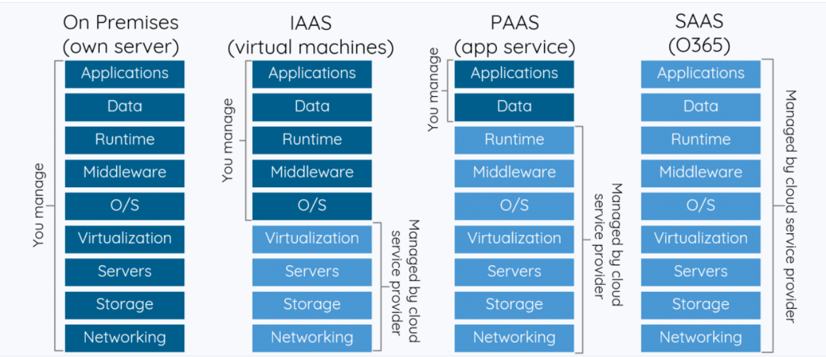

Slide 10
Major Cloud Providers
When it comes to providing services, the big players in the corporate computing sphere include:
Microsoft Azure
Google Cloud
Amazon Web Services (AWS)
IBM Cloud
Alibaba Cloud

Slide 11

Microsoft Azure

Slide 12
Account, Subscriptions and its Types
An Azure account is tied to a specific identity and holds information like:
Name, email, and contact preferences
Billing information such as a credit card
Azure offers free and paid subscription options to suit different needs and requirements. The most commonly used subscriptions are:
Free
Pay-As-You-Go
Enterprise Agreement
Student

Slide 13
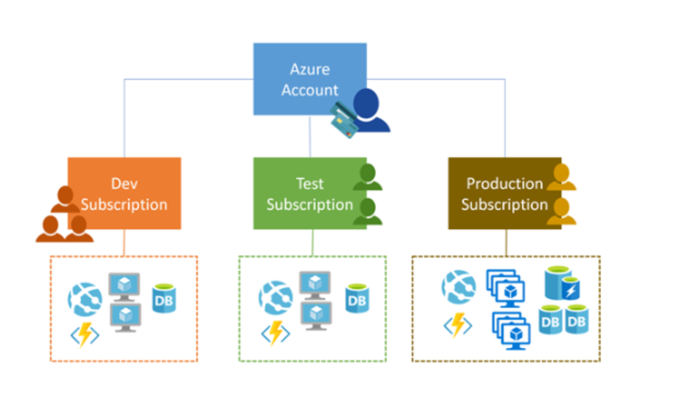

Slide 14
Let’s Meet in Next Session
Thanks Kanika

